Slide 1
PYTHON -INTRODUCTION

Slide 2
PYTHON Applications
GUI PROGRAMMING
GAME DEVELOPMENT
SCRIPTING
SYSTEM ADMINISTRATION
DB APPLICATIONS

Slide 3
PYTHON PLUSES
EXPRESSIVE LANGUAGE
IT IS MORE CAPABLE TO EXPRESSING THE CODE’S PURPOSE THAN MANY OTHER LANGUAGES
SIMPLER SYNTAX
EASY OF USE
CROSS PLATFORM LANGUAGE:
IT CAN RUN EQUALLY WELL ON VARIOUS PLATFORMS-WINDOWS, LINUX, SMARTPHONE ETC.,
PORTABLE LANGUAGE

Slide 4
PYTHON PLUSES
INTERPRETED LANGUAGE:
IT IS AN INTERPRETED LANGUAGE NOT A COMPILED LANGUAGE.
EXECUTES LINE BY LINE
EASY TO DEBUG
COMPLETENESS:
WHEN YOU INSTALL PYTHON YO WILL GET EVERYTHING-ADDITIONAL LIBRARIES-VARIOUS MODULES ETC.,

Slide 5
PYTHON PLUSES
FREE AND OPEN SOURCE :
IT IS FREELY AVAILABLE WITHOUT ANY COST
OPEN SOURCE- CAN IMPROVE, MODIFY, EXTEND
CROSS PLATFORM LANGUAGE:
IT CAN RUN EQUALLY WELL ON VARIOUS PLATFORMS-WINDOWS, LINUX, SMARTPHONE ETC.,
PORTABLE LANGUAGE

Slide 6
PYTHON MINUSES
NOT THE FASTEST LANGUAGE
LESSER LIBRARIES THAN C,JAVA,PEARL
NOT STRONG ON TYPE BINDING
NOT EASILY CONVERTIBLE

Slide 7
TOKENS
SMALLEST INDIVIDUAL UNIT IN A PROGRAM ARE CALLED TOKENS OR LEXICAL UNITSOR LEXICAL ELEMENTS.
The different types of Tokens
Reserved Words
Identifiers
Literals
Operators

Slide 8
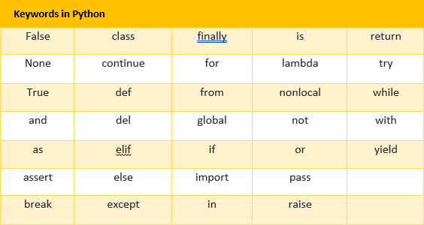
KEYWORDS
RESERVED WORDS
CONVEY A SPECIAL MEANING TO THE LANGUAGE COMPILER /INTERPRETER

Slide 9
IDENTIFIERS
FUNDAMENTAL BUILDING BLOCKS OF THE PROGRAMS
GENERAL TERMINOLOGY FOR THE NAMES GIVEN TO THE DIFFERENT PARTS OF THE PROGRAM
RULES :
UPPER AND LOWER CASES ARE DIFFERENT
DIGITS CAN BE A PART OF AN IDENTIFIER EXCEPT FOR THE FIRST CHARACTER
THE FIRST CHARACTER MUST BE A LETTER OR UNDERSCORE(_)
THESE ARE UNLIMITED IN LENGTH
IT IS CASE SENSITIVE
THEY CANNOT BE KEYWORDS

Slide 10
RULES FOR NAMING AN IDENTIFIER
1. UPPER AND LOWER CASES ARE DIFFERENT
A=25
print A //25
print a error
2. DIGITS CAN BE A PART OF AN IDENTIFIER EXCEPT FOR THE FIRST CHARACTER
A123,S1ER,a1000 ARE THE VALID IDENTIFIERS
1QWE,09ER ARE THE INVALID IDENTIFIERS

Slide 11
RULES FOR NAMING AN IDENTIFIER
3.THE FIRST CHARACTER MUST BE A LETTER OR UNDERSCORE(_).
EG:
AB_CD,_GFH,I_90P ARE VALID
4.THESE ARE UNLIMITED IN LENGTH
5.IT IS CASE SENSITIVE

Slide 12
RULES FOR NAMING AN IDENTIFIER
5.IT CANNOT BE A KEYWORD
if=20,print=‘abc’ are invalid
6.IT CANNOT CONTAIN ANY SPL CHARACTER EXCEPT UNDERSCORE(_)
EXAMPLE:ABC DF,NAME-OF,QW.ER ARE INVALID

Slide 13
IDENTIFY THE VALID AND INVALID IDENTIFIERS
myfile
su_per_PY
ZT12Z
DATA REC
break
FOR
_YOYO

Slide 14
LITERALS
LITERALS ARE ALSO CALLED AS CONSTANTS
LITERALS ARE DATA ITEMS THAT HAVE A FIXED VALUE.
TYPES OF LITERALS
STRING LITERAL
NUMERIC LITERAL
BOOLEAN LITERAL
SPECIAL LITERAL None
OTHER LITERALS- TUPLE,LIST ETC

Slide 15
STRING LITERAL
THE TEXT ENCLOSED IN QUOTES FORMS A STRING LITERAL
EG:’ABCD’,”WELCOME”,”A”
STRING LITERALS CAN BE ENCLOSED WITH IN EITHER SINGLE OR DOUBLE QUOTES.

Slide 16
NON GRAPHIC CHARACTERS
PYTHON ALLOWS YOU TO HAVE CERTAIN NON GRAPHIC CHARACTER IN STRING VALUES.
NON GRAPHIC CHARACTERS ARE THOSE CHARACTERS THAT CANNOT BE TYPED THROUGH KEYBOARD.
IN PYTHON STRINGS, THE BACKSLASH "\" IS A SPECIAL CHARACTER, ALSO CALLED THE "ESCAPE" CHARACTER.
IT IS USED IN REPRESENTING CERTAIN WHITESPACE CHARACTERS: "\t" IS A TAB, "\n" IS A NEWLINE,

Slide 17
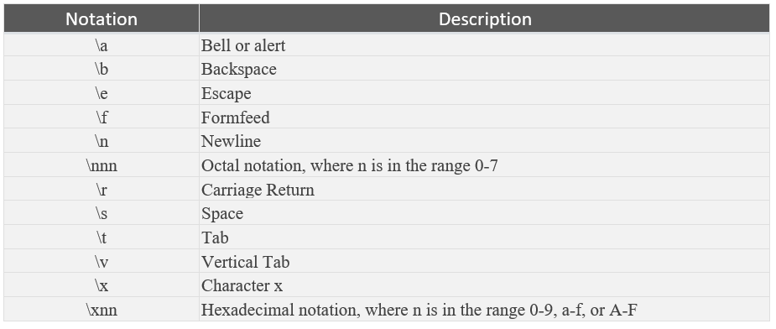
Some escape characters

Slide 18
NUMERIC LITERALS
Numeric literals can be any one of the following literals
Integers:positive integers or negative integers
Floats:real numbers-written with a decimal point dividing the integer and fractional parts

Slide 19
INTEGER LITERALS
Integer literals are the whole numbers without any fractional part.
An integer constant must have atleast one digit and nust not contain any decimal point.
It may contain either (+) sign or (-) sign.A number with no sign is assumed to be positive.
Commas cannot appear in integer constant

Slide 20
FLOATING POINT LITERAL
FLOATING POINT LITERAL ARE ALSO CALLED REAL LITERAL ARE NUMBERS HAVING FRACTIONAL PARTS.
THESE MAY WRITTEN IN ONE OF THE TWO FORMS CALLED FRACTIONAL FORM OR EXPONENT FORMS.

Slide 21
FRACTIONAL FORM:
A REAL LITERAL IN FRACTIONAL FORM CONSISTS OF SIGNED OR UNSIGNED DIGITS INCLUDING A DECIMAL POINT BETWEEN DIGITS.
A REAL CONSTANT IN FRACTIONAL FORM MUST HAVE ATLEAST ONE DIGIT WITH THE DECIMAL POINT,EITHER BEFORE OR AFTER.
IT MAY ALSO HAVE EITHER + OR – SIGN PRECEDING IT.
A REAL CONSTANT WITH NO SIGN IS ASSUMED TO BE POSITIVE.

Slide 22
EXPONENT FORM:
A REAL LITERAL IN EXPONENT FORM
CONSISTS OF TWO PARTS:
MANTISSA AND EXPONENT
FOR EXAMPLE,0.98x10³ =0.98E03
THE PART APPEARING BEFORE E(0.98) IS MANTISSA AND AFTER E IS EXPONENT FORM
E03 REPRESENTS 10³
THE MANTISSA MUST BE EITHER INTEGER OR PROPER REAL CONSTANT.THE MANTISSA FOLLOWED BY A LETTER E OR e AND THE EXPONENT.THE EXPONENT MUST BE AN INTEGER.

Slide 23
VALID AND INVALID REAL LITERALS
152E05
1.52E05
152.0E08
.25E-4
1.7E
0.12E2.3

Slide 24
BOOLEAN LITERALS
A BOOLEAN LITERALS IN PYTHON IS USED TO REPRESENT ONE OF THE TWO BOOLEAN VALUES ie., True or False
print(10<11) True
print(9>10) False

Slide 25
SPECIAL LITREAL NONE
A None LITERAL INDICATE ABSENCE OF A VALUE.
THE None VALUE IN PYTHON MEANS “THERE IS NO USEFUL INFORMATION “ OR “THERE’S IS NOTHING HERE”
EXAMPLE: A=10
B=None
print(A) 10
print(B) None

Slide 26
IDENTIFY THE TYPE OF LITERALS
23789
“23789”
0o765
0XA456
-9.76544
True
“False”
0XFACE
None

Slide 27
TYPE()
TYPE() method return the type of the passed variable.
Eg: x,y=23,5.9
print(type(x),type(y))
<class 'int'> <class 'float'>

Slide 28
Bool()
Bool() method is used to return or convert a value to a boolean value.,True or False
For example.,
x=20,y=0
print(bool(x))
print(bool(y))
True
False

Slide 29
OPERATORS
OPERATORS ARE TOKENS THAT TRIGGER SOME COMPUTATION WHEN APPLIED TO VARIABLES AND OTHE OBJECTS IN AN EXPRESSION.
VARIABLES TO WHICH THE COMPUTATION IS APPLIED ARE CALLED OPERANDS.

Slide 30
TYPES OF OPERATORS
UNARY OPERATORS
UNARY OPERATORS REQUIRE ONE OPERAND TO OPERATE UPON.
UNARY PLUS +
UNARY MINUS -
LOGICAL NEGATION not

Slide 31
BINARY OPERATORS
BINARY OPERATORS ARE THOSE OPERATORS THAT REQUIRE TWO OPERANDS TO OPERATE UPON.
ARITHMETIC OPERATORS:
+,-,*,/,%,**,//
IDENTITY OPERATORS:
is, is not

Slide 32
RELATIONAL OPERATOR:
<,<=,>,>=,==,!=
ASSIGNMENT OPERATOR:
=,/=,+=,-=,*=,%=,**=//=
LOGICAL OPERATOR:
and
or
MEMBERSHIP OPERATORS:
in
not in

Slide 33
COMMENTS
COMMENTS ARE THE READABLE INFORMATION,WHICH IS READ BY THE PROGRAMMERS BUT IGNORED BY THE INTERPRETER.
COMMENTS BEGIN WITH #
TYPES OF COMMENTS:
PHYSICAL LINE COMMENT: BEGIN WITH #ARE THE FULL LINE COMMENTS
EXAMPLE:#THIS IS MY FIRST PROGRAM
INLINE COMMENT:IT STARTS IN THE MIDDLE OF PHYSICAL LINE .
EXAMPLE:print(x,y) #printing x and y

Slide 34
COMMENTS
MULTILINE COMMENT:
ADD # SYMBOL IN THE BEGINNING OF EVERY PHYSICAL LINE PART OF THE MULTILINE COMMENTS
EXAMPLE:
#PROGRAM- FINDING AREA OF CIRCLE
#PI=3.14 OR 22/7
#FORMULA:AREA=3.14*R*R*H

Slide 35
OUTPUT #1
A,B=12,13
C,B=A*2,A/2
print(A,B,C)
X=10
X=X+10
X=X+5
print(x)
X,Y=X-2,22
print(X,Y)

Slide 36
Output#2
a,b=12,13
print(print(a+b))

Slide 37
type(0)
type(int(‘0’))
type(‘0’)
type(1.0)
type(int(1.0))
type(int(1.0))
type(float(0))
type(float(1.0))
type(3//3)
type(int(0))

Slide 38
bool(0)
bool(1)
bool(‘0’)
bool(“”)
bool(0.0)
bool(‘0.0’)
bool(‘0j’)
bool(0j)

Slide 39
DYNAMIC TYPING
A Variable pointing to a value of a certain type, can be made to point to a value /object of different type.
a=9.8
print(a)
a=“pyprogram”
print(a)
output: 9.8
pyprogram

Slide 40
The variable does not have any type but the value it points to does have a type.So we can make a variable point to a value of different type by reassigning a value of that type.Python will not raise an error. This feature is called dynamic typing.
x=10
y=0
y=x/2
x=‘rrr’
y=x/2 Error.A string cannot be divided

Slide 41
APPLICATION BASED QUESTIONS
From the following , find out which assignment statement will produce an error.
x=55
y=037
Z=0o98
56thnumber=3300
length=450.17
!Taylor=‘instant’
this variable=87.E02
float=.17E-03
FLOAT=0.17E-03

Slide 42
2. Find out the error(s) in the following code: i) temperature=90 iv)print(“X=“X)
print temperature v)X=24
ii)a=30 4=X
b=a+b
print(a And b) vi)else=21-5
iii)a,b,c=2,8,9
print(a,b,c)
c,b,a=a,b,c
print(a;b;c)

Slide 43
Find the output
3.
x=10
x=x+10
x=x-5
print(x)
x,y=x-2,22
print(x,y)

Slide 44
What is the problem with the following code fragments?
i)a=3
print(a)
b=4
print(b)
s=a+b
print(s)
ii)name=“prejith”
age=26
print(“your name & age are”,name+age)
iii)a=3
s=a+10
a=“new”
q=a/10

Slide 45
Predict the output
i)x=40
y=x+1
x=20,y+x
print(x,y)
ii)x,y=20,60
y,x,y=x,y-10,x+10
#y,x,y=20,50,30
print(x,y)
iii)a,b=12,13
c,b=a*2,a/2
print(a,b,c)

